Slide 1

Linux
Why not?

Slide 2
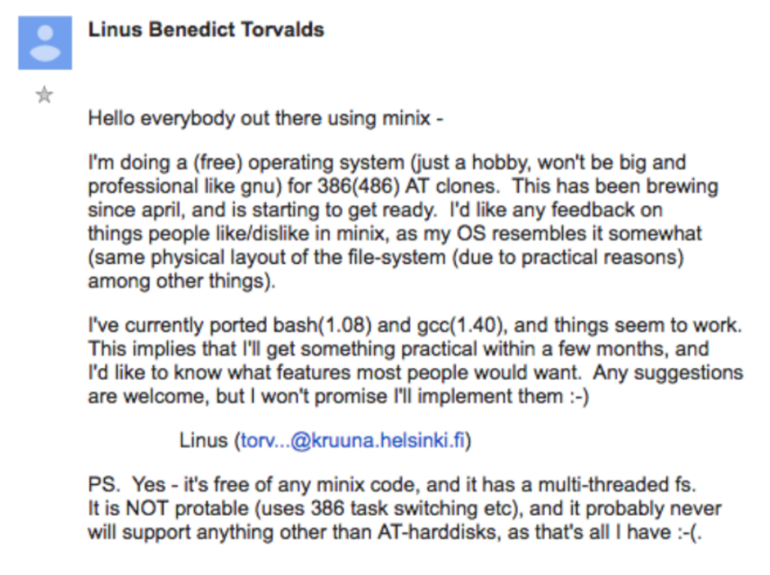
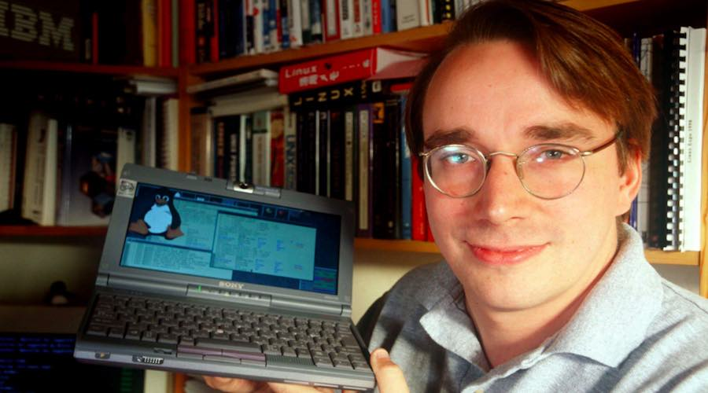
history
Creation: Linux began in 1991 as a personal project by Finnish student Linus Torvalds to create a new free operating system kernel.
https://groups.google.com/g/comp.os.minix/c/dlNtH7RRrGA/m/SwRavCzVE7gJ

Slide 3
Stats
Market Share and Usage:
Linux powers 39.2% of websites whose operating system is known, compared to 22% for Windows.
47.7% of the top 1,000 websites and 38.8% of the top 10,000 websites globally use Linux.
96.3% of the top one million web servers run on Linux.
Linux is the third most popular desktop OS, with a market share of 2.09%.
Developer Adoption:
47% of professional developers use Linux-based operating systems.
Windows remains the top choice for 61% of developers, while 44% use MacOS.
Only 3% use Windows Subsystem for Linux, and 1% use other operating systems.
Mobile Dominance:
Linux powers 85% of smartphones.
Mobile devices account for over half of the entire global internet traffic today, where Linux dominates.
Supercomputers and Servers:
All of the world’s top 500 fastest supercomputers run on Linux.
SpaceX has used Linux-supported systems for 65 missions, including the famous Falcon 9 missions.

Slide 4
DISTROS
What Is a Linux Distro?
A Linux distribution (distro) is an operating system built from open-source components.
It includes the Linux kernel and additional software to create a functional environment.
Distro Differences:
Philosophy: Distros have varying philosophies.
Default Software: Each distro comes with specific default software
Package Management: Different package managers handle software installation.
Stability vs. Cutting-Edge: Some prioritize stability, while others offer bleeding-edge features.
Purpose: Distros for servers, desktops, or specialized tasks.
Choosing a Distro:
There are 600+ Linux distros
Consider your goals and expertise.
Try as many as you can and get ready to change when needed or forced
"You don’t chose a Linux Distro, a Linux Distro choses you." Jose Santos

Slide 5
Kernel
What is Linux Kernel: The Linux kernel is the core of the Linux operating system. It is a free and open-source.
Function: The Linux kernel manages the system’s resources and facilitates communication between hardware and software components.
Hardware Abstraction and Management: The Linux kernel manages and abstracts the underlying hardware, allowing the software to interact with the system without needing to know its specific details.
Memory Management: The Linux kernel’s memory management subsystem is responsible for managing the system’s memory. This includes the implementation of virtual memory and demand paging, memory allocation for both kernel internal structures and user space programs, and mapping of files into processes’ address space
Process Management: The kernel determines which processes can use the central processing unit (CPU), when, and for how long.
File System Management: The kernel manages the file system, providing a way for applications to store and retrieve data.
Network Management: The kernel handles networking tasks, allowing the system to communicate with other systems over a network.
Maintenance: The Linux kernel is managed by Linus and maintained by a community of developers.
Linus created Git to support the Linux Kernel work: https://github.com/torvalds/linux *

Slide 6
DISTROS
Ubuntu: Ubuntu’s philosophy is rooted in the concept of “Ubuntu”, an African-origin value system that emphasizes the interconnectedness of individuals with their surrounding societal and physical worlds. Ubuntu is designed to be user-friendly and comfortable, and it aims to be the platform that leads in achieving these ideals.
Debian: Debian’s philosophy is deeply rooted in the values of free software and the belief that software should be developed, shared, and maintained without a profit motive. Debian ensures that what they distribute is free for derivatives to modify and redistribute to their audience.
Fedora: Fedora has a reputation for focusing on innovation, integrating new technologies early on and working closely with upstream Linux communities. Fedora Linux is developed by the Fedora Project and aims to be on the leading edge of open-source technologies.
Mint: Linux Mint is focused on ease of use, appealing design, stability, and feedback from its users. It is designed to work ‘out of the box’ and comes fully equipped with the apps most people need. Linux Mint has a traditional philosophy regarding which versions of the software to use, prioritizing stable versions that have been highly tested and are known to work.
Kali Linux: Kali Linux is a free, open-source operating system used for advanced penetration testing and security auditing. It is designed for ethical hackers and security professionals who need to test their systems’ vulnerabilities. Kali Linux provides several hundred common tools and industry-specific modifications, targeted towards various information security tasks.

Slide 7
Installation
Choose a Linux Distribution
Download the Linux Distribution
Create Bootable Installation Media: This can be done using a USB drive or a writeable DVD1.
Boot Your Linux Installation Media: To install an OS onto a computer, you must boot to the OS installer.
Install Linux: Follow the installation prompts to install Linux on your system. This includes selecting your preferred language, choosing the installation type (e.g., alongside an existing operating system or on a new partition), creating a username and password for your Linux account, and selecting the installation location.
Dual boot: There is an option to install Linux alongside windows and have the option to boot with each one

Slide 8
Graphical interfaces
A Linux graphical interface, also known as a desktop environment, is a system of interactive visual components for a computer or system software. It includes components such as a taskbar, windows, launcher menus, etc.
GNOME: GNOME’s philosophy is to keep things available but not visible. It is free-of-charge software characterized by its simplicity and attractiveness. The developers focus on details like fonts rendering or icons design.
KDE: KDE offers a potent graphical user interface (GUI) that can be customized, making it ideal for individuals who enjoy personalization. It sticks with the menus at all times and provides numerous choices for customization.
Cinnamon: Cinnamon is a fork of the GNOME 3 desktop and appears to be intended as the GNOME desktop that never was. It focuses on being flexible and efficient, providing a balance between functionality and resource efficiency.
XFCE: XFCE embodies the traditional Unix philosophy of modularity and re-usability. It is known for its lightweight and efficient nature, making it suitable for systems with lower hardware resources.
LXDE: LXDE is an extremely fast-performing and energy-saving desktop environment. It focuses on being an application launcher and provides a clean and simple desktop.
MATE: MATE is a continuation of GNOME 2, providing an intuitive and attractive desktop environment using traditional metaphors. It is under active development to add support for new technologies while preserving a traditional desktop experience.

Slide 9
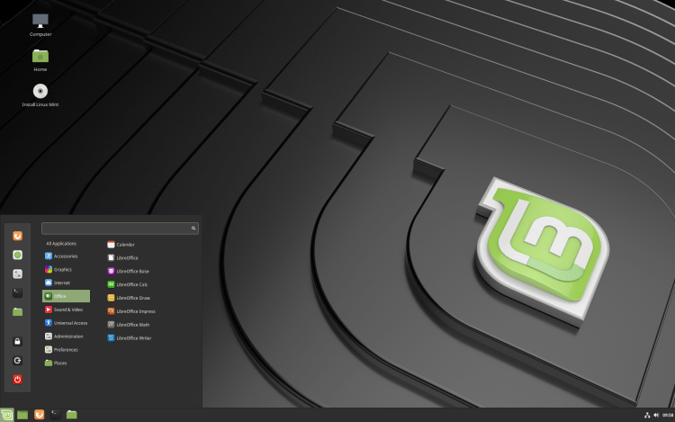
Graphical interfaces

Slide 10
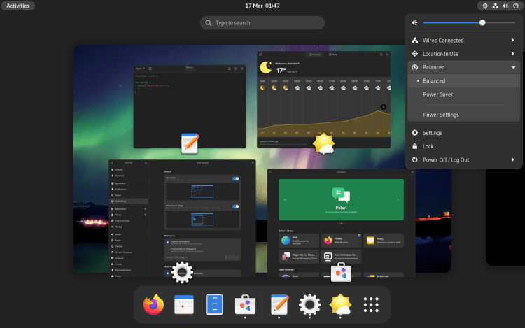
Graphical interfaces

Slide 11
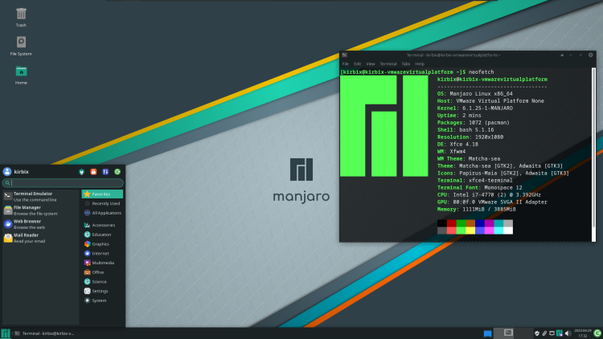
Graphical interfaces

Slide 12
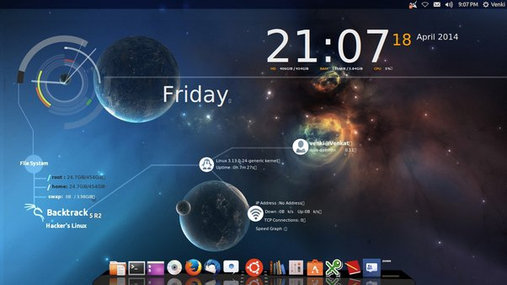
Graphical interfaces

Slide 13
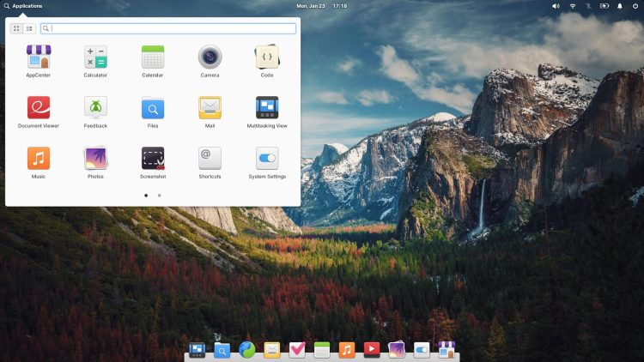
Graphical interfaces

Slide 14
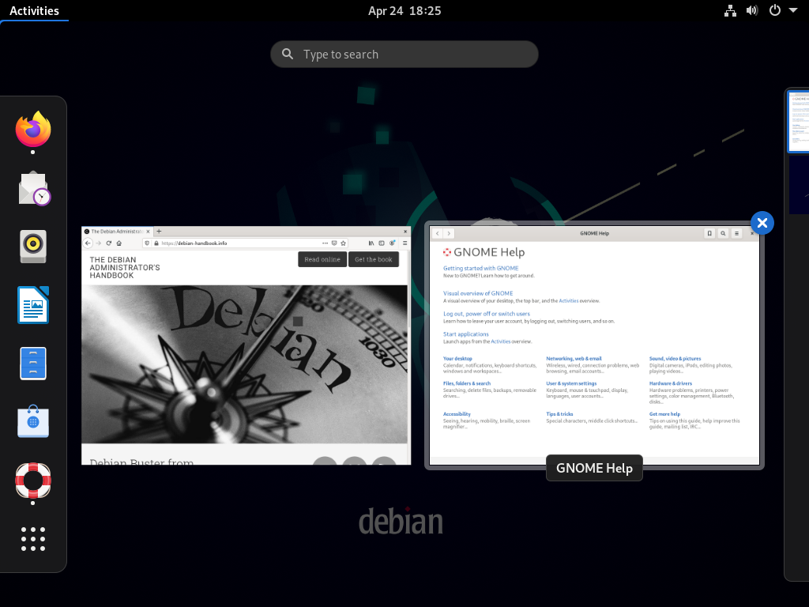
Graphical interfaces

Slide 15
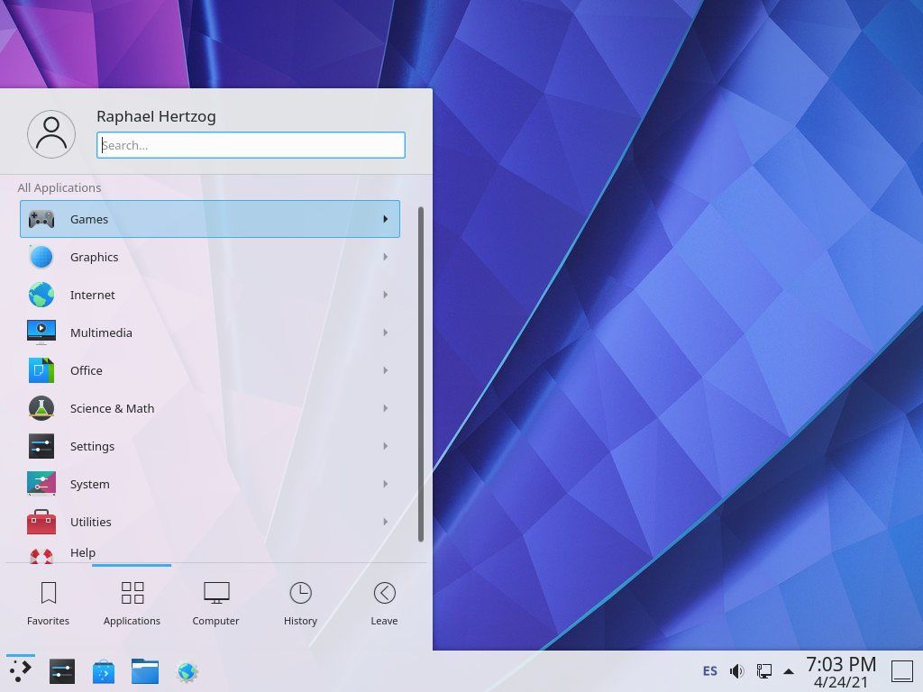
Graphical interfaces

Slide 16
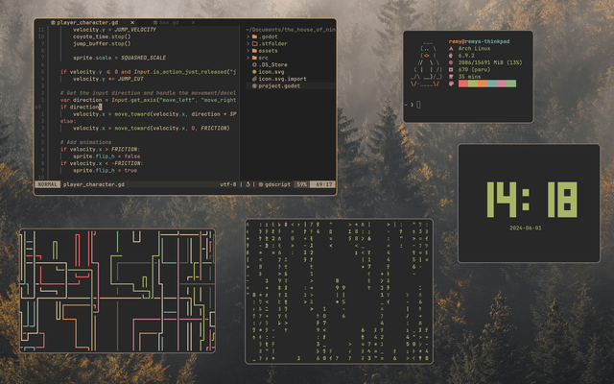
Graphical interfaces

Slide 17
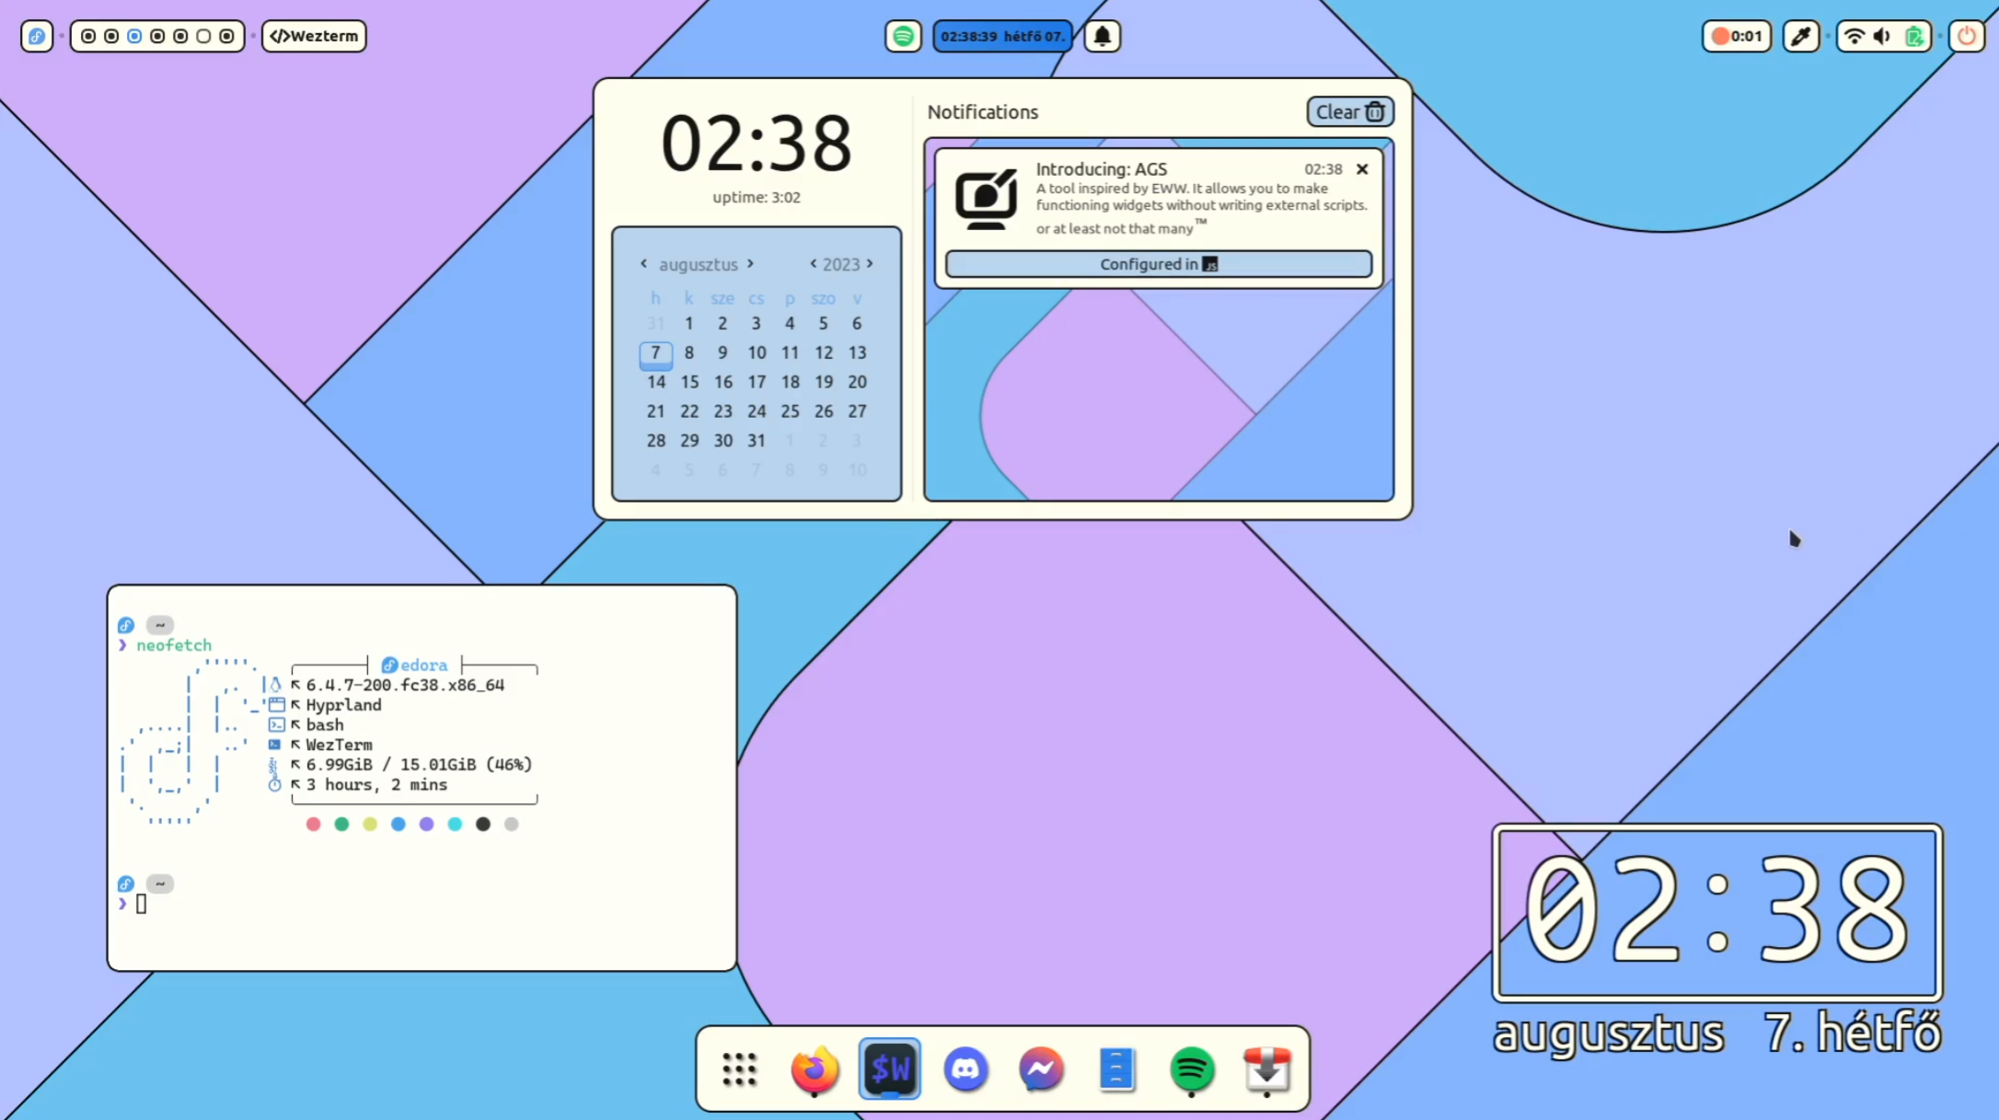
Graphical interfaces

Slide 18
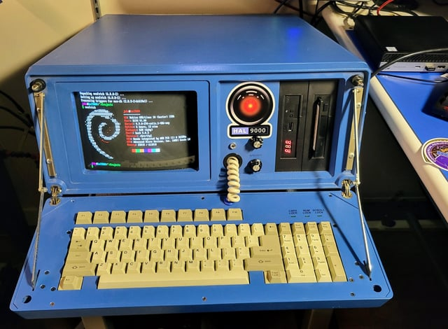
Graphical interfaces

Slide 19
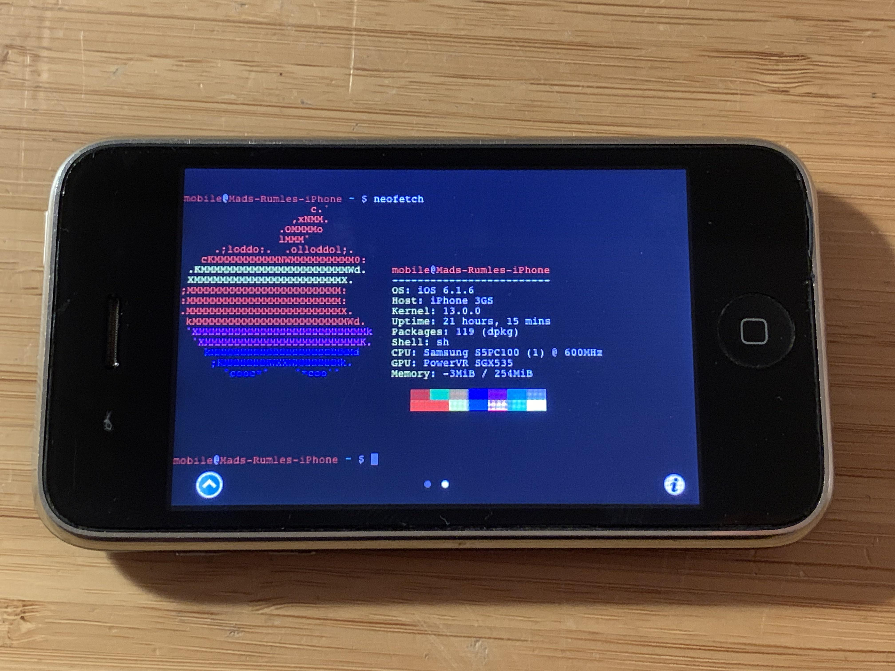
Graphical interfaces

Slide 20
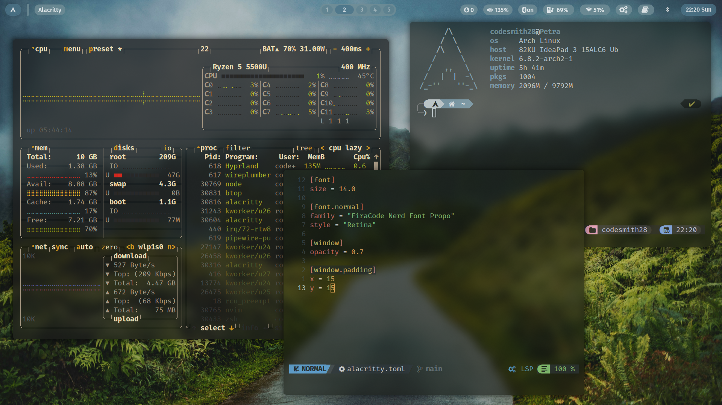
Graphical interfaces

